Slide 1
Chris Quirk Session 3
Making changes? Really?

Slide 2
Making changes? Really? Walking with the Lord in the light of His Word
Ephesians

Slide 3
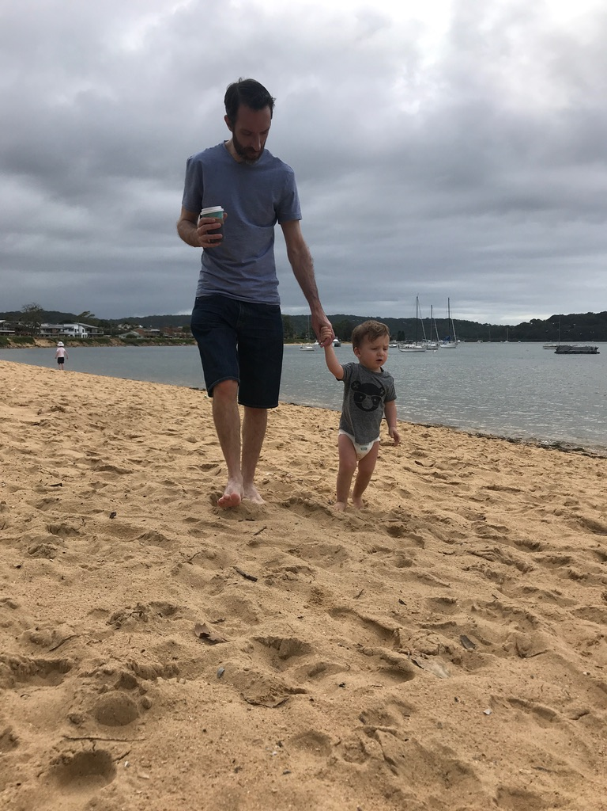
Walking faithfully with the Lord
as a child of God.

Slide 4
1
¹⁵ For this reason, ever since I heard about your faith in the Lord Jesus and your love for all God’s people, ¹⁶ I have not stopped giving thanks for you, remembering you in my prayers. ¹⁷ I keep asking that the God of our Lord Jesus Christ, the glorious Father, may give you the Spirit of wisdom and revelation, so that you may know him better. ¹⁸ I pray that the eyes of your heart may be enlightened in order that you may know the hope to which he has called you, the riches of his glorious inheritance in his holy people, ¹⁹ and his incomparably great power for us who believe. That power is the same as the mighty strength ²⁰ he exerted when he raised Christ from the dead and seated him at his right hand in the heavenly realms, ²¹ far above all rule and authority, power and dominion, and every name that is invoked, not only in the present age but also in the one to come. ²² And God placed all things under his feet and appointed him to be head over everything for the church, ²³ which is his body, the fullness of him who fills everything in every way.

Slide 5
How to make changes –
- Pray for knowledge of God

Slide 6
Pray to know God better
Just a closer walk with Thee Grant it, Jesus, is my plea Daily walking close to Thee Let it be, dear Lord, let it be
By Patsy Cline

Slide 7
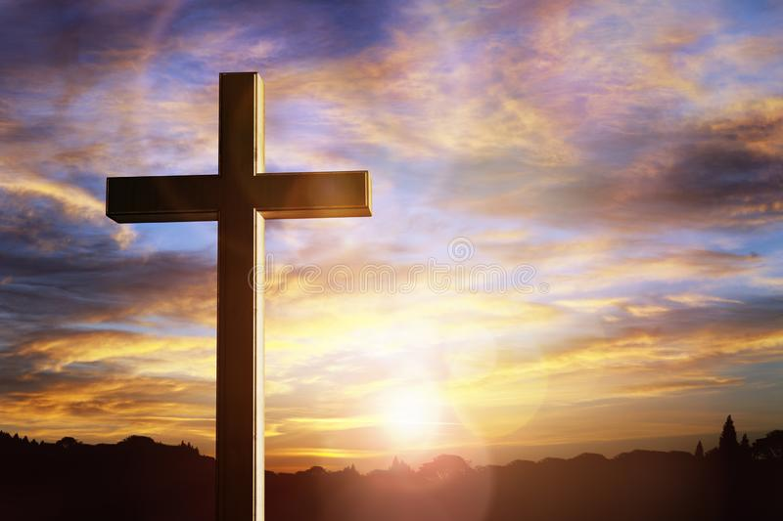
Pray to know our hope

Slide 8
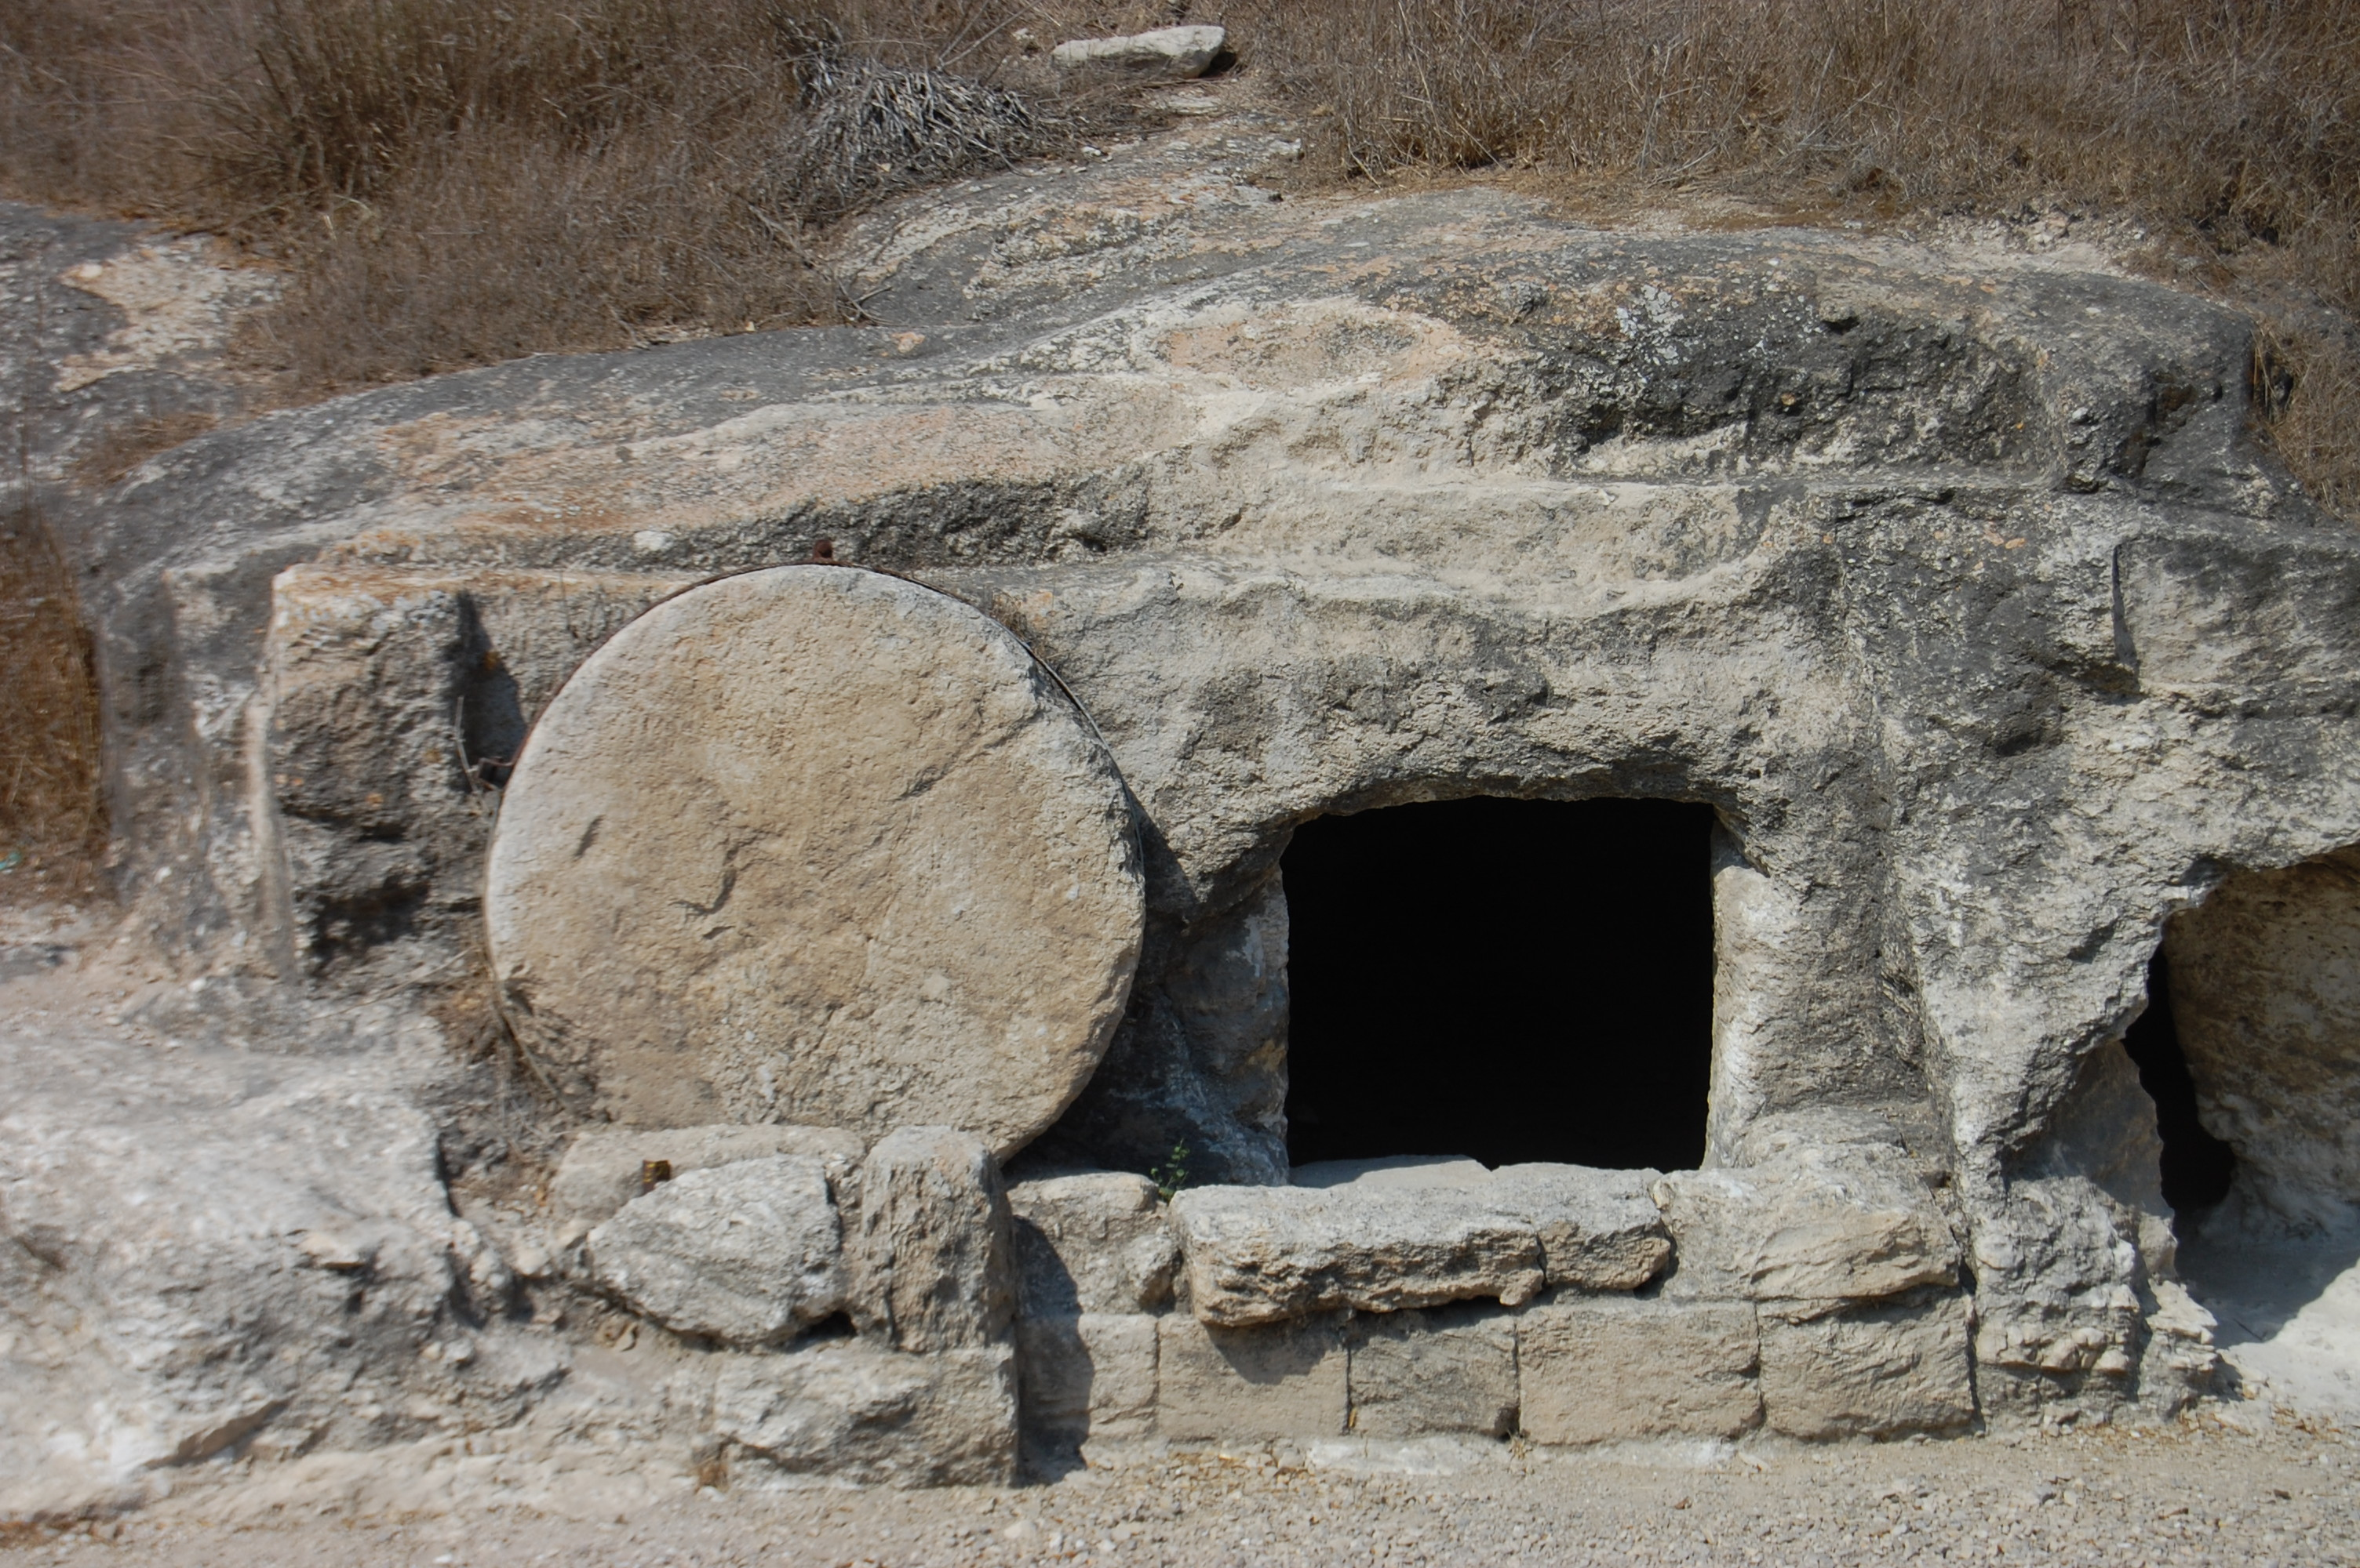
Pray to know God’s power

Slide 9
3
¹⁴ For this reason I kneel before the Father, ¹⁵ from whom every family^{[a]} in heaven and on earth derives its name. ¹⁶ I pray that out of his glorious riches he may strengthen you with power through his Spirit in your inner being, ¹⁷ so that Christ may dwell in your hearts through faith. And I pray that you, being rooted and established in love, ¹⁸ may have power, together with all the Lord’s holy people, to grasp how wide and long and high and deep is the love of Christ, ¹⁹ and to know this love that surpasses knowledge—that you may be filled to the measure of all the fullness of God.
²⁰ Now to him who is able to do immeasurably more than all we ask or imagine, according to his power that is at work within us, ²¹ to him be glory in the church and in Christ Jesus throughout all generations, for ever and ever! Amen.

Slide 10
How to make changes –
- Pray for knowledge
- Pray to be strengthened with power

Slide 11
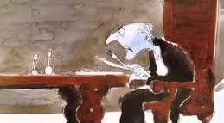
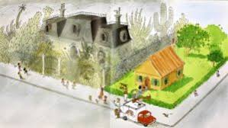

Slide 12
6
¹⁰ Finally, be strong in the Lord and in his mighty power. ¹¹ Put on the full armor of God, so that you can take your stand against the devil’s schemes. ¹² For our struggle is not against flesh and blood, but against the rulers, against the authorities, against the powers of this dark world and against the spiritual forces of evil in the heavenly realms. ¹³ Therefore put on the full armor of God, so that when the day of evil comes, you may be able to stand your ground, and after you have done everything, to stand. ¹⁴ Stand firm then, with the belt of truth buckled around your waist, with the breastplate of righteousness in place, ¹⁵ and with your feet fitted with the readiness that comes from the gospel of peace. ¹⁶ In addition to all this, take up the shield of faith, with which you can extinguish all the flaming arrows of the evil one. ¹⁷ Take the helmet of salvation and the sword of the Spirit, which is the word of God.
¹⁸ And pray in the Spirit on all occasions with all kinds of prayers and requests. With this in mind, be alert and always keep on praying for all the Lord’s people.

Slide 13
How to make changes –
- Pray for knowledge
- Pray to be strengthened with power
- Put on all your armour

Slide 14
Stand firm

Slide 15
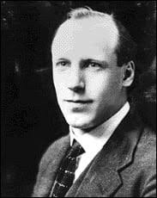
Eric Liddell

Slide 16
How to make changes:
- Pray for knowledge
- Pray to be strengthened with power
- Put on all your armour and pray

Slide 17
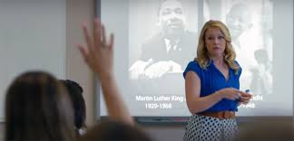
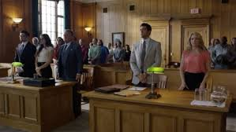

Slide 18
“To the praise of His glory.”
Eph 1: 6, 12, 13

Slide 19
2021

